Slide 1
MVM & MVCV
Limitations of current technologies:
  Data driven testing is complex
Purpose:
  Allows user to test with various input data
  Increases the scope of a test case
Notes:
Data driven tests are complex as it is not very user friendly to test with multiple data sets. Multi-valued Macros allows you to test with multiple data sets.
When used in the testcase worksheet, allows ZUG to auto-generate unique testcases using a new combination of values from each of the MVMs used in the testcase.
Test case identifiers are automatically generated by ZUG, by concatenating the base id with the combination values
When used inside the molecules worksheet, invokes the step multiple times, each time with a new combination of values (within the context of the parent test case).

Slide 2
Multi-valued Macros (MVM)
Multi-value macros (MVM) contain lists of values
SYNTAX:
$$QUERY={manual testing, automation testing}
Primarily used as iteration vehicles
Can be used inside a test case or a molecules
Notes:
Multi-valued macros (MVM) contain lists of values, When used in the test case worksheet, allows ZUG to auto-generate unique test cases using a new combination of values from each of the MVMs used in the test case.
When used inside the molecules worksheet, invokes the step multiple times, each time with a new combination of values (within the context of the parent test case).
To declare Multi-valued Macros, the syntax is double dollar with a name as suffix e.g. $$macro_name in the first column of the Macro sheet and its corresponding value is written in the second column inside the curly braces as comma separated list e.g. {a, b, c}.

Slide 3
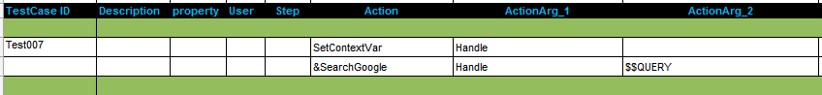
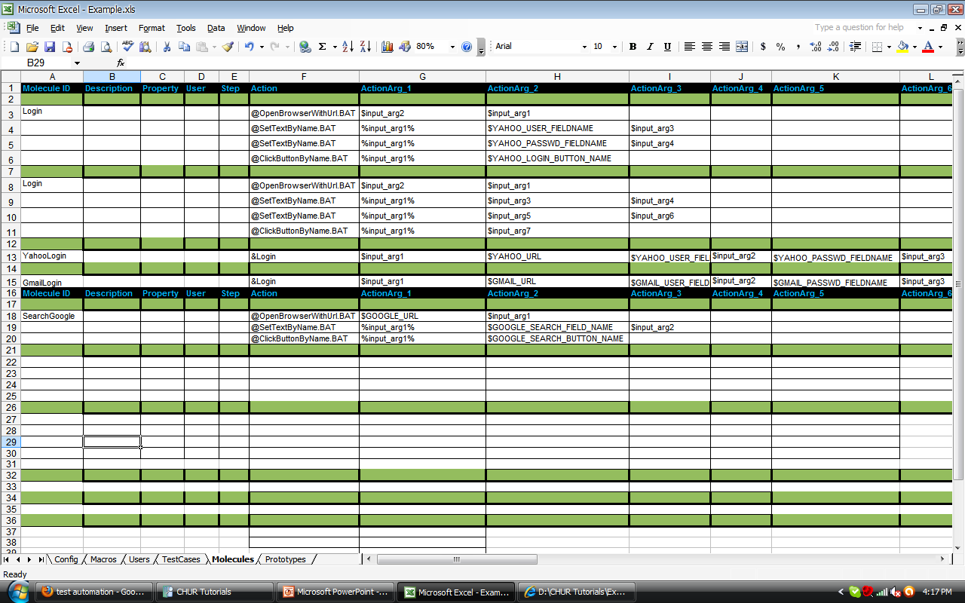
MVM in Test Case
The same test case can test with multiple search queries
Notes:
$$QUERY is used which has the two values (test +automation, test –automation)
So when the test case is run it would take the first value “manual testing” and the second time it would take the second value “automation testing”
Hence the same test case will generate unique test case ids for different values of the MVM.

Slide 4
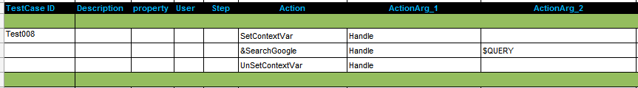
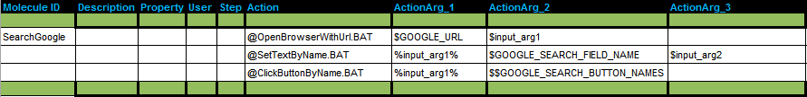
MVM in Molecule
Test Case
Molecule

Slide 5
MVM Features
Range of values
  e.g. {1..3}
Test Case identifications are auto-generated
  e.g. Test001_1, Test001_2 and so on.
Syntax for passing MVMs
Notes:
MVM can contain a range of values that can be specified as {1..5}, then the MVM will be treated as a list with values {1,2,3,4,5}.
When MVMs are used inside a Test Case it autogenerates the test case identifier with MVM values appended to the original test case identifier to make them unique.
MVM values are comma (,) separated so you should be careful not use comma inside the braces.

Slide 6
Exercise : MVM
Write a test case to search in Google with different queries in a single MVM
Notes:
Example Sheet - Test008

Slide 7
Cartesian MVM
Cartesian product over the set of values of all the MVM
Ex
$FILE_NAME={File1.txt, File2.rtf}
$LOCATION={C:\TempFolder, \\Network\SharedFolder}
references both these MVMs as $$ FILE_NAME, and $$LOCATION will generate 4 test case
[ File1.txt, C:\TempFolder ],
[ File2.rtf, C:\TempFolder ],
[ File1.txt, \\Network\SharedFolder ],
[ File2.txt, \\Network\SharedFolder ]
Notes:
Cartesian MVM expansion can be useful when all the combinations of all the MVMs present in a test case or Molecule, need to be exercised.
If more than one MVM is used in a test case then a cartesian product over the set of values of all the MVMs is calculated.
example.

Slide 8
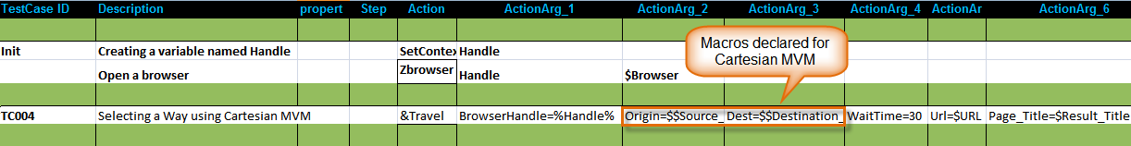
Cartesian MVM
Search all the combinations of Source to Destinations

Slide 9
Indexed MVM
Performs indexing of two MVM.
Both MVM must have same no of elements.
Ex:
  $FILE_NAME={File1.txt, File2.rtf}
  $LOCATION={C:\TempFolder,\\Network\SharedFolder}
  Index both the MVM
    $FILE_NAME_LOCATION={$$FILE_NAME, $$LOCATION}
Notes:
The syntax to expand an indexed MVM is to reference the MVM which contains the names of the other MVMs to be expanded as an indexed MVM, and append the name of the MVM prefixed by a hash (#).

Slide 10
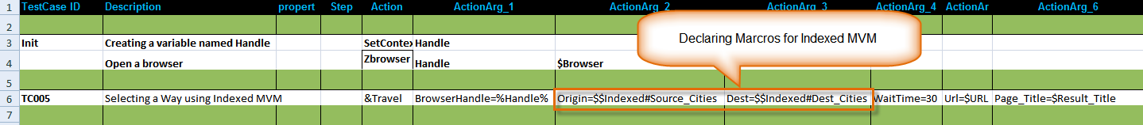
Indexed MVM
Using index MVM
  $$FILE_NAME_LOCATION#FILE_NAME and $$FILE_NAME_LOCATION#LOCATION expand to
    [ File1.txt, C:\TempFolder ]
    [ File2.txt, \\Network\SharedFolder ]
Notes:
In the above example we show indexed MVM works.
We define two macros
$Source_Cities={Washington,Detroit}
$Dest_Cities={London,Liverpool}
$Indexed={$$Source_Cities,$$Dest_Cities}
The macros are called in the test case as Origin=$$Indexed#Source_Cities and
Dest=$$Indexed#Dest_Cities
The resulting search will be
i)from Washington to London and
ii)from Detroit to Liverpool.

Slide 11
Multi-valued Context Variable
Limitation of MVM
  Iterates on predefined values
  Cannot change the values at run time
Can change the value at run time
Can generate a MVCV at run time.
Notes:
A dynamically generated MVCV cannot be expanded in the same test case or molecule in which it is generated.
It should be expanded by passing it into another molecule or in another test case.

Slide 12


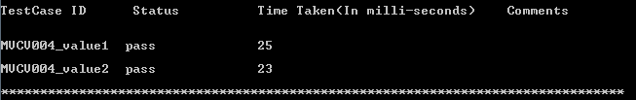
Multi-valued Context Variable
Contains a list of values
Test Case or Molecule executed once for each value
Notes:
Only Cartesian expansion for MVCV.

Slide 13

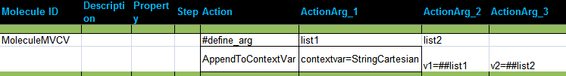
Multi-valued Context Variable
Used in Molecule
  Passing by Value

Slide 14

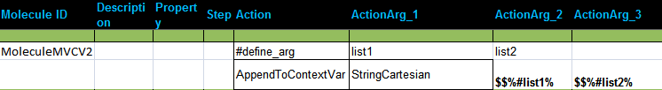
Multi-valued Context Variable
Used in Molecule
  Passing by Reference

